Slide 1

Pareto analysis

Slide 2

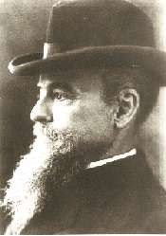
Named after Vilfredo Pareto -an Italian economist
He observed in 1906 that 20% of the Italian population owned 80% of Italy's wealth.

Slide 3



What is it
One of the 7 tools of Quality Management
Statistical technique in decision making for selection of limited tasks which have significant overall impact

Slide 4

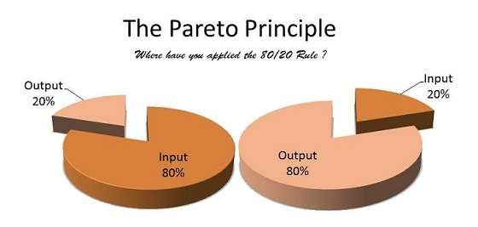
Pareto Principle
Doing 20% of work generates advantage of 80% of entire job
In terms of quality improvement, large majority of problems (80%) are created by a few key causes (20%).
Separating the Vital Few from the Trivial Many

Slide 5

Pareto Chart
A Pareto Chart is a series of bars whose heights reflect the frequency or impact of problems.
The bars are arranged in descending order of height from left to right.
Bars on left are relatively more important than the bars on the right
Separates the vital from the trivial

Slide 6


how is “pareto Chart” Constructed
For example, if a business was investigating the delay associated with processing credit card applications, the data could be grouped into the following categories: no signature, residential address not valid, non-legible handwriting, already a customer, and other.

Slide 7

Step 1: Record the raw data
Analysis sheet
Category | Frequency
No address | 9
Non-legible writing | 22
Current Customer | 15
No Signature | 40
Other | 8

Slide 8

Step 2: Order the data
Analysis sheet
Category | Frequency
No Signature | 40
Non-legible writing | 22
Current Customer | 15
No address | 9
Other | 8

Slide 9

Step 3:
Determine the percentage that each category represents.
Analysis sheet
Category | Frequency | Percentage
No Signature | 40 | 43%
Non-legible writing | 22 | 23%
Current Customer | 15 | 16%
No address | 9 | 10%
Other | 8 | 8%

Slide 10

Step 4:
Determine the percentage that each category represents.
Analysis sheet
Category | Frequency | Percentage | Cumulative Percentage
No Signature | 40 | 43% | 43%
Non-legible writing | 22 | 23% | 66%
Current Customer | 15 | 16% | 82%
No address | 9 | 10% | 92%
Other | 8 | 8% | 100%

Slide 11
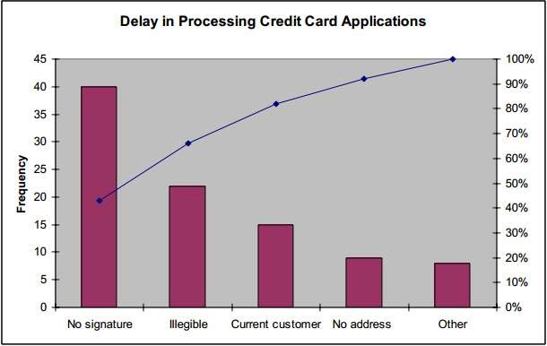
Step 5: Prepare & Analyze the diagram

Slide 12

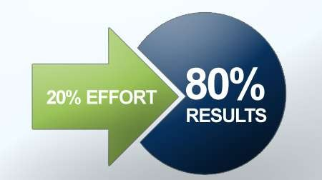
the Pareto Principle in Work-Life
Problem Solving
To-Do List of the day
Passion
Relationship
Cut the Clutter

Slide 13

Problem Solving
Pareto Analysis can really help in identifying the most critical problem to solve as well as the level of criticality.
Identify and list problems and their causes.

Slide 14

To-Do List of the day
Estimate a value % in terms of goal achievement or satisfaction against each of your tasks for the day – email, customer calls, reports, specific tasks.
What 20% of the tasks listed contribute to 80% of the goals you seek to achieve?
Concentrate on these tasks first in your most productive period of the day.

Slide 15

Passion
certain “activities” account for the greatest amount of happiness and satisfaction. These activities are the ones that we feel most passionately about.
Once you have identified your passions, be very careful of the time spent on those 80% activities that produce little satisfaction for you.
No one really benefits if you are not happy or passionate about what you are doing.
Apply Pareto to not only find your passions but also pursue them by comparing the results against the efforts you need to put in.

Slide 16

Relationships
20% of the people you know give you 80% of your joy and support.
Observe your friends, office colleagues and social circle.
Compare that to the amount of stress or joy you are getting in return.

Slide 17

Cut the Clutter
Most people only use 20% of what they own on a regular basis.
A good part of the other 80% is things we used in the past or we think we may use in the future.
This basically means that about 80% of our possessions just sit around every day, doing nothing more than gathering dust or occupying space.
Take a look at your desk, cupboard, files on your computer – if you have not used something in the past year, it is highly unlikely you will ever use it. Lighten your load – throw, delete, donate that 80%.

Slide 18

Breaks a big problem down into smaller pieces
Identifies the most significant factors
Shows where to focus efforts & allows better use of limited resources.
Helps to separate the few major problems from the many
possible problems.

